Slide 1
SOFTWARE MAINTENANCE

Slide 2
Software Maintenance
The First Law of Software Engineering “No matter where you are in the system life cycle, the system will change, and the desire to change it will persist throughout the life cycle” Bersoff et al. (1980)
within days, bug reports filter back to the software engineering organization.
within weeks, one class of users indicates that the software must be changed so that it can accommodate the special needs of their environment.
within months, another corporate group who wanted nothing to do with the software when it was released, now recognizes that it may provide them with unexpected benefit. They’ll need a few enhancements to make it work in their world.
All of this work is software maintenance

Slide 3
Maintainable Software
Exhibits effective modularity
Use design patterns that allow ease of understanding.
Constructed using well-defined coding standards and conventions, leading to source code that is self-documenting and understandable.
Undergone quality assurance techniques that have uncovered potential maintenance problems before the software is released.
created by software engineers who recognize that they may not be around when changes must be made.
Therefore, the design and implementation of the software must “assist” the person who is making the change

Slide 4
Software Supportability
The capability of supporting a software system over its whole product life.
any necessary needs or requirements 🡪equipment, support infrastructure, additional software, facilities, manpower, or any other resource required to maintain the software operational and capable of satisfying its function.
Assist support personnel when a defect is encountered in the operational environment
Support personnel should have access to a database that contains records of all defects that have already been encountered—their characteristics, cause, and cure.

Slide 5
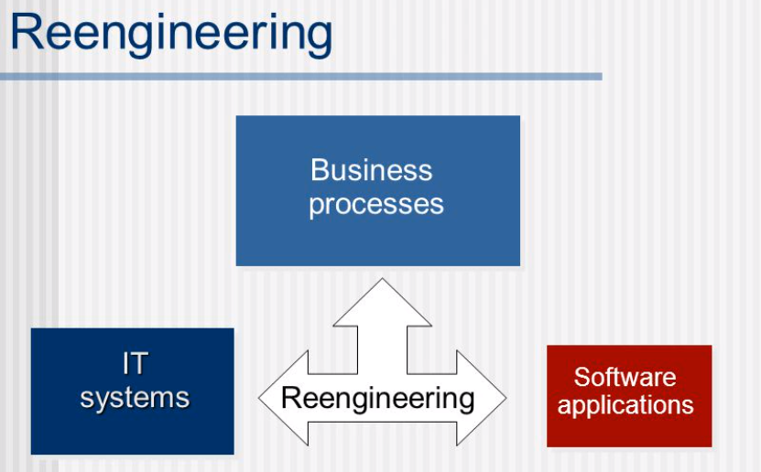
Reengineering is defined as the redesign of business processes—and the associated systems and organizational structures—to achieve an improvement in business performance.

Slide 6
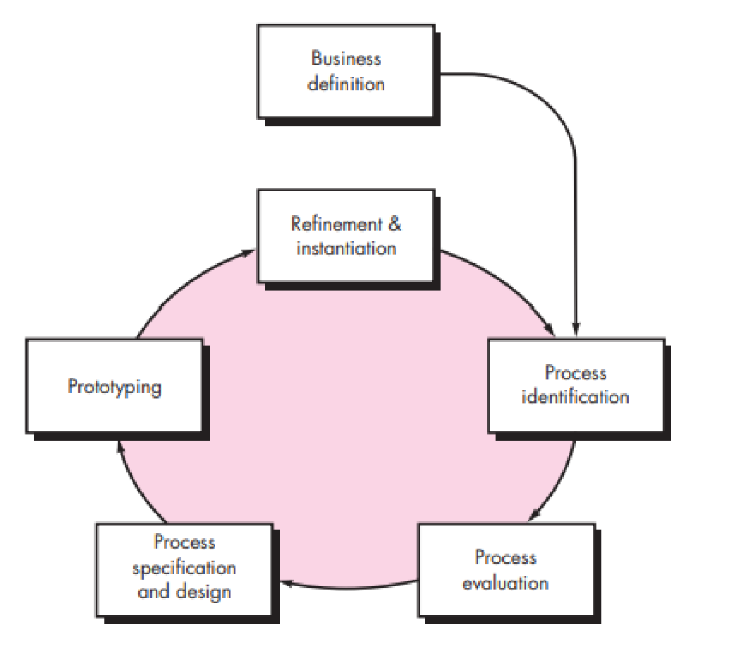
Business Process Reengineering
Business:- Business goals are identified within the context of four
key drivers: cost reduction, time reduction, quality improvement,
and personnel development and empowerment.
Process identification:- Processes that are critical to
achieving the goals defined in the business definition are identified.
Process evaluation:- The existing process is thoroughly
analyzed and measured.
Process specification and design:- Based on information
obtained during the first three BPR activities, use-cases are
prepared for each process that is to be redesigned.
Prototyping:- A redesigned business process must be prototyped before it is fully integrated into the business.
Refinement and instantiation:- Based on feedback from the prototype, the business process is refined and then instantiated within a business system.

Slide 7
BPR Principles
Organize around outcomes, not tasks.
Have those who use the output of the process perform the process.
Incorporate information processing work into the real work that produces the information.
Treat geographically dispersed resources as though they were centralized.
Link parallel activities instead of integrating their results.
Put the decision point where the work is performed, and build control into the process.
Capture data once, at its source.

Slide 8
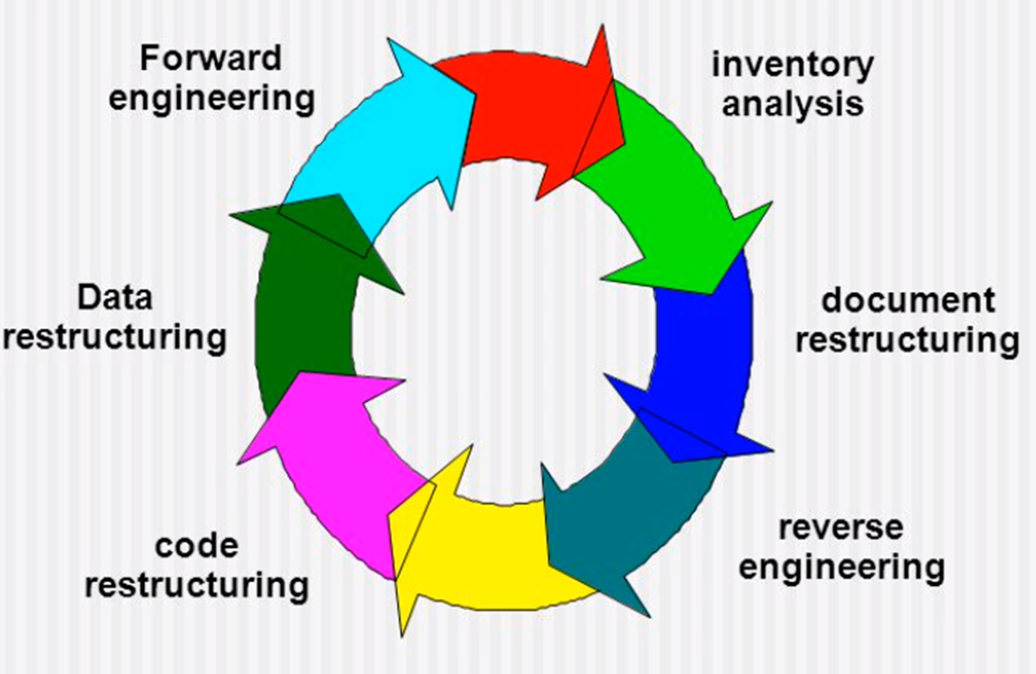
Software Re-engineering
a process of software development which is done to improve the maintainability of a software system.
Re-engineering is the examination and alteration of a system to reconstitute it in a new form. This process encompasses a combination of sub-processes like reverse engineering, forward engineering, reconstructing etc.

Slide 9
Inventory Analysis
build a table that contains all applications
establish a list of criteria,
e.g: name of the application
year it was originally created
number of substantive changes made to it
total effort applied to make these changes
date of last substantive change
effort applied to make the last change
system(s) in which it resides
applications to which it interfaces, ...
analyze and prioritize to select candidates for reengineering
Document Restructuring
Creating documentation is far too time consuming.
If the system works, we’ll live with what we have.
Documentation must be updated, but we have limited resources.
We’ll use a “document when touched” approach. It may fully redocument an application.
The system is business critical and must be fully redocumented.
Even in this case, an intelligent approach is to spare documentation to an essential minimum.

Slide 10
Reverse Engineering
Reverse engineering is a process that examines an existing product to determine detailed information and specifications in order to learn how it was made and how it works
reverse engineering for software is the
process of analyzing a program in an effort to create a representation of the program at a higher level of abstraction than source code.
process of design recovery.
Reverse engineering tools extract data, architectural, and procedural design information from an existing program
Code Restructuring
Source code is analyzed using a restructuring tool.
Poorly design code segments are redesigned
Violations of structured programming constructs are noted and code is then restructured
The resultant restructured code is reviewed and tested to ensure that no anomalies have been introduced
Internal code documentation is updated.

Slide 11
Data Restructuring
Unlike code restructuring, which occurs at a relatively low level of abstraction, data structuring is a full-scale reengineering activity
Data restructuring begins with a reverse engineering activity.
Current data architecture is dissected and necessary data models are defined
Data objects and attributes are identified, and existing data structures are reviewed for quality.
When data structure is weak (e.g., flat files are currently implemented, when a relational approach would greatly simplify processing), the data are reengineered.
The data architecture has a strong influence on program architecture and the algorithms that populate it, changes to the data will invariably result in either architectural or code-level changes.

Slide 12
Forward Engineering
The cost to maintain one line of source code may be 20 to 40 times the cost of initial development of that line.
Redesign of the software architecture (program and/or data structure), using modern design concepts, can greatly facilitate future maintenance.
Because a prototype of the software already exists, development productivity should be much higher than average.
The user now has experience with the software🡪new requirements and the direction of change can be ascertained with greater ease.
CASE tools for reengineering will automate some parts of the job.
A complete software configuration (documents, programs and data) will exist upon completion of preventive maintenance.

Slide 13
Economics of Reengineering
A cost/benefit analysis model for reengineering has been proposed by Sneed [Sne95].
Nine parameters are defined:
P1 = current annual maintenance cost for an application.
P2 = current annual operation cost for an application.
P3 = current annual business value of an application.
P4 = predicted annual maintenance cost after reengineering.
P5 = predicted annual operations cost after reengineering.
P6 = predicted annual business value after reengineering.
P7 = estimated reengineering costs.
P8 = estimated reengineering calendar time.
P9 = reengineering risk factor (P9 = 1.0 is nominal).
L = expected life of the system.
The cost associated with continuing maintenance of a candidate application (i.e., reengineering is not performed) can be defined as
Cmaint = [P3 - (P1 + P2)] x L
The costs associated with reengineering are defined using the following relationship:
Creeng = [P6 - (P4 + P5) x (L - P8) - (P7 x P9)] `
Using the costs presented in equations above, the overall benefit of reengineering can be computed as
cost benefit = Creeng - Cmaint

Slide 14
